Slide 1

Reaching out of current customers for additional Business in the banks leads to increased profitability to the banks. Most of customers in banks are depositors (liability customers)and few are asset customers(have personal loans). Converting the liability customers to asset customers boosts the bank revenue through interest on loan.
CROSS-SELLING OF FINANCIAL PRODUCTS.
PROJECT PREPARED BY:
SAMUEL WAIRIUKO

Slide 2
Background
The purpose of this project is to identify the liability customers and cross-sell them more personal loans and at the same time retain the asset customers.
The target variable in this case is personal loan.

Slide 3
OBJECTIVES
To identify the potential customers.
To convert the liability customers to personal loan customers while retaining them as depositors
To reduce the marketing budget through better understanding of the market target

Slide 4
CONTEXT
Bank personal loan modelling dataset from Kaggle.com was read through excel file to R Programming language for statistical analysis.
The data set includes4999 observations with fourteen variables
Kaggle.com/itsmesunil/bank-loan-modelling

Slide 5
PACKAGES USED
library(xlsx) read the excel file
library(dplyr) # used for data manipulation
library(ggplot2)
Library lattice# to load
Library(plyr)read the head of the dataset
Library (nutshell)load data about measures of spread

Slide 6
Project questions
#1.How many customers have personal loan account compared to those without?
#2.How many customers have securities account compared to those without?
#3.how is the distribution of credit cards to the customers?
#4.How is the distribution of online accounts to customers?
#5.how is the income distribution by education?
#6.how is the Income distribution and online account?
#7.how are the Age groups and online banking?
#8.How is the distribution of customers by experience?
#9.How is the credit card usage by customers from different levels of income?
#10.How is the distribution of income with different family sizes?

Slide 7
Data preparation
Finding a dataset from Kaggle.com
1.Reanding the dataset from excel file ;
Install the packages("readxl")
Read excel(.xlsx)
Set objectives and project questions
Wrote the codes for data analysis.
Presentation of findings using graphs and tables
Findings and conclusions.

Slide 8
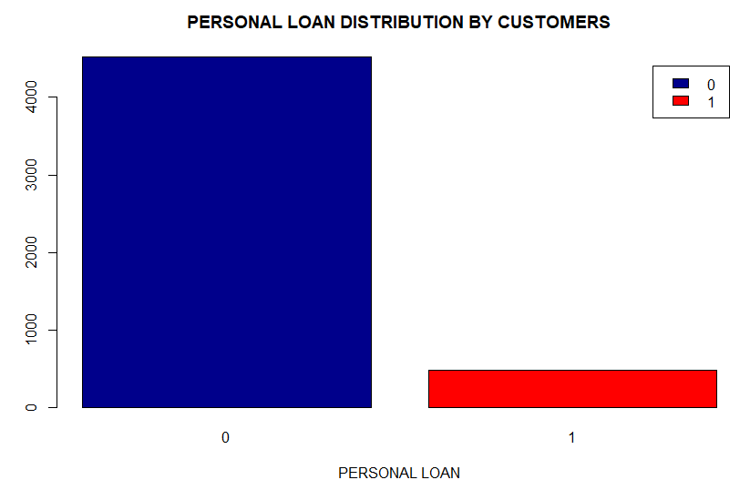

Data and Visual Analysis
91% of customers in data base have no personal loan Accounts
Key:
0=No P_loan Account
1=Yes P_loan Account

Slide 9
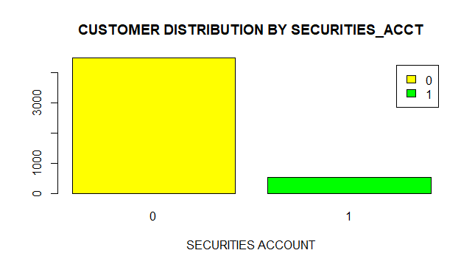

Data and Visual Analysis
More with no Securities Account and few with Securities Account
Key:
0=No S_ Account
1=Yes S_ Account

Slide 10
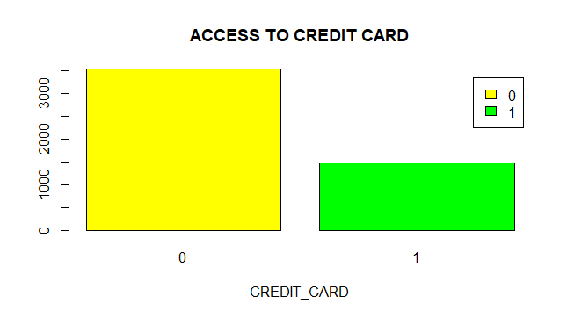
Distribution of Credit Cards to Customers

Slide 11
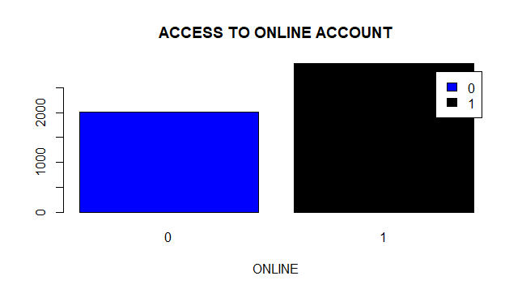
Customers with Online Accounts

Slide 12
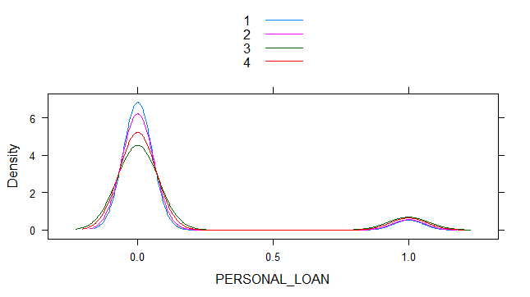
Personal loan distribution by family size
FAMILY vs PERSONAL_LOAN
1 2 3 4 Sum
0 1365 1190 877 1088 4520
1 106 106 133 134 479
Sum 1471 1296 1010 1222 4999

Slide 13
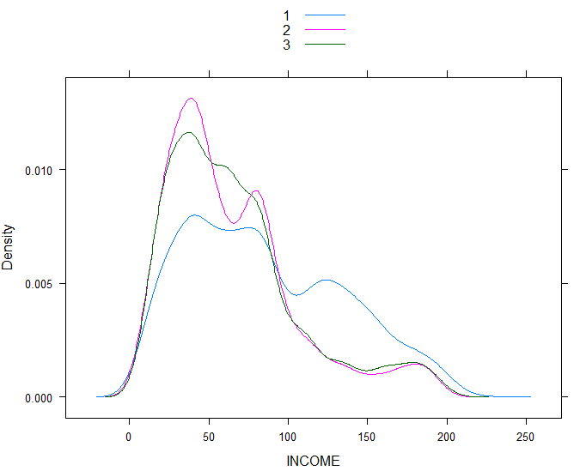
INCOME BY EDUCATION LEVEL.5
Education Level
Levels (1 and 2) have average income between 50k and 100k
We seem to have less number of professional(level3) than level (2 and 1)
Education level1 and 2, has a slump just above income 50k.

Slide 14
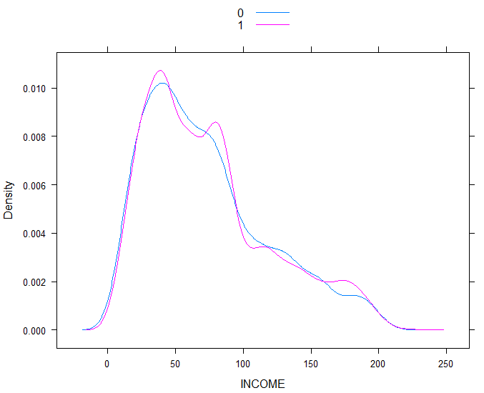
Income Distribution VS Online banking
Online Banking [No=o,1=Yes
We have almost an equal number of customers using online banking, though those with Online banking tend to have higher income .

Slide 15
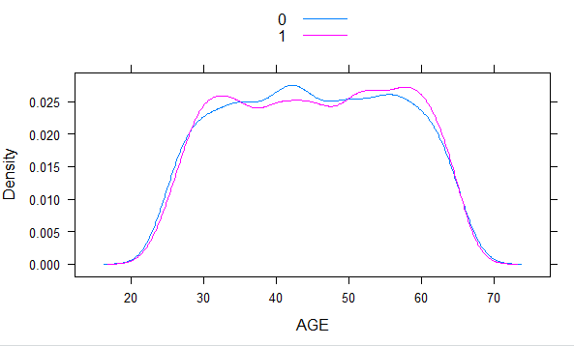
Age and Online banking
Online Banking [No=0,1=Yes
Average age of 40 to 45 have less clients using online banking and slightly more above50years.

Slide 16
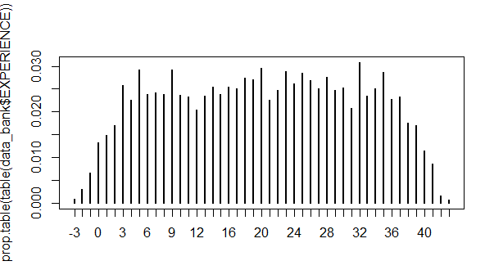
Experience Analysis
Even experience distribution from 3years to35 years with few outliers
Drop in proportion above 35years of experience

Slide 17
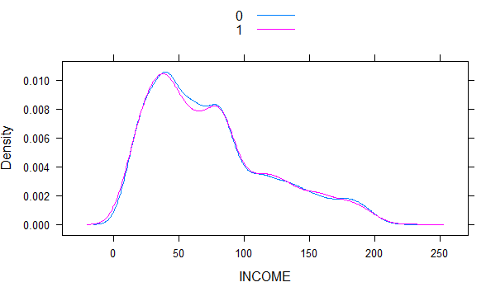
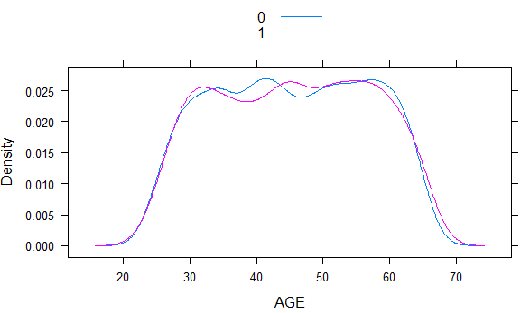
Income And Credit Card Use
Credit card Use[No=0,1=Yes
More clients not using credit cards for income 40k to 80k
In terms of Age we have more clients between 35 and 40 not using credit cards and also age 55 to 60years.
Credit card Use[No=0,1=Yes

Slide 18
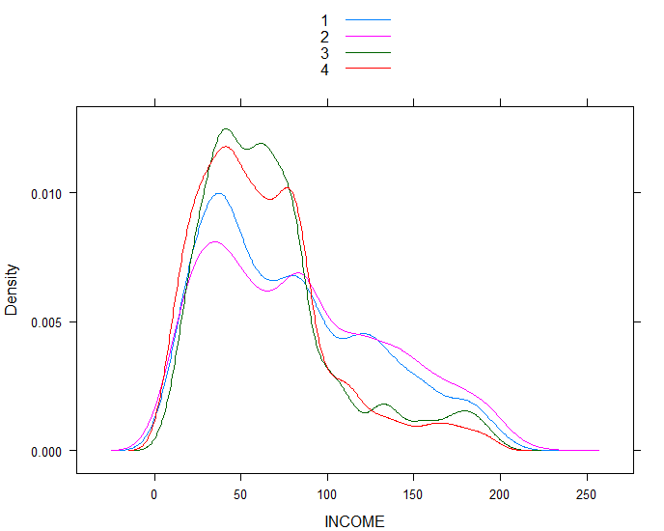
Income Distribution per family Size

Slide 19
FINDINGS AND CONCLUSION
Most of the customers are between age 30yrs and 60yrs.
Cross selling of loans to the clients without personal loan will increase profits through loan interest and reduce the marketing budget.
More clients not using credit cards for income 40k to 80kIn terms of Age we have more clients between 35 and 40 not using credit cards and also age 55 to 60years.

Slide 20
Findings And Conclusion
A few of the customers have personal loans ,credit card and securities accounts. At least half of the customers have online accounts
Income is positively skewed because there are a few people earning above 100000. the bank can target this group and sell more personal loans
Most of the customers are aged between age 30yrs and 60yrs.so the bank should come up with a personal loan product that best suit this group .
Most of the customers have family size ranging 1 to 4 so the bank should come up a children's saving account

Slide 21
PROJECT CODES
getwd()
setwd("C:\\Users\\User\\Desktop\\SAMMR")
install.packages("readxl")
library(readxl)
data_bank=read_excel("r_bankproject.xlsx")
View(data_bank)
str(data_bank)
head(data_bank)
as.factor(data_bank$PERSONAL_LOAN)
as.factor(data_bank$SECURITIES_ACCT)
as.factor(data_bank$ONLINE)
as.factor(data_bank$CREDIT_CARD)
as.factor(data_bank$`CERT_OF_DEP_ ACCT`)

Slide 22
CODES CONT’
summary(data_bank)
dim(data_bank)
names(data_bank)
#q1
table(data_bank$ PERSONAL_LOAN)
counts <- table(data_bank$PERSONAL_LOAN)
barplot(counts, main="PERSONAL LOAN DISTRIBUTION BY CUSTOMERS",
xlab="PERSONAL LOAN",col=c("darkblue","red"),
legend = rownames(counts))
#q2
table(data_bank$SECURITIES_ACCT)
counts <- table(data_bank$SECURITIES_ACCT)
barplot(counts, main="CUSTOMER DISTRIBUTION BY SECURITIES_ACCT",
xlab="SECURITIES ACCOUNT",col=c("YELLOW","GREEN"),
legend = rownames(counts))

Slide 23
CODES CONT’
#q3
table(data_bank$CREDIT_CARD)
counts <- table(data_bank$CREDIT_CARD)
barplot(counts, main="ACCESS TO CREDIT CARD",
xlab="CREDIT_CARD",col=c("YELLOW","GREEN"),
legend = rownames(counts))
#q4
table(data_bank$ONLINE)
counts <- table(data_bank$ONLINE)
barplot(counts, main="ACCESS TO ONLINE ACCOUNT",
xlab="ONLINE",col=c("BLUE","BLACK"),
legend = rownames(counts))
#q5
densityplot(~ INCOME, groups = EDUCATION, data = data_bank,
plot.points = FALSE, auto.key = TRUE)

Slide 24
CODES CONT’
#q6
densityplot(~ INCOME, groups = ONLINE, data = data_bank,
plot.points = FALSE, auto.key = TRUE)
#q7
densityplot(~ AGE, groups = ONLINE, data = data_bank,
plot.points = FALSE, auto.key = TRUE)
#q8
plot(prop.table(table(data_bank$EXPERIENCE)))
#q9
densityplot(~ INCOME, groups = CREDIT_CARD, data = data_bank,
plot.points = FALSE, auto.key = TRUE)
#q10
densityplot(~ INCOME, groups = FAMILY, data = data_bank,
plot.points = FALSE, auto.key = TRUE)

